Slide 1

Kavach AI Based Cyber Hygiene Tool Business Plan

Slide 2
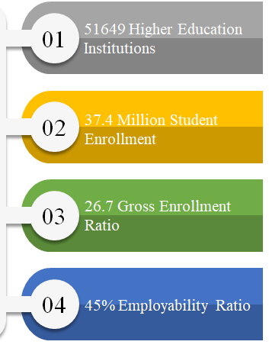
The National Cyber Crime division Landscape
Lack of Cybersecurity Awareness
Propogation of Advanced Rasomewares
Government feeling the need to add more restrictions.
Strategic Management, corporatization, high-performance culture and total quality assurance are emerging themes
Accreditation, ranking and regulatory frameworks are data-driven, requiring significant institutional effort

Slide 3
Gap Analysis-IHE
Low penetration of Analytics and Business Intelligence
Management lacks insights into all aspects of institutional performance
Low involvement of all stake-holders
Outdated mechanisms to measure performance and track strategic interventions.
Regulatory compliances and accreditation processes require significant effort
Real-time, on-demand data and insights not available

Slide 4

The Solution – Kavach
Helps define and enforce a process approach towards ensuring fulfillment of institutional quality parameters and outcomes.
Provides analytics on all quality parameters – User-wise, industry-wise, department-wise through dashboards, pre-canned and on-demand custom reports.
Seamless, automatic generation of reports for all distributions.
Performance tracking and benchmarking for all systems.
Quality assurance is democratized and decentralized

Slide 5
PI-360 Key Aspects
01
Cloud Based Solution
SaaS model, hosted on AWS
02
System Configuration
Product setup and operation-ready in one minute.
03
System Usability
Intuitive, ease-of-use, low training requirement
04
Data Entry Effort
Realtime data collection and processing
Notes:
© Copyright PresentationGo.com – The free PowerPoint template library

Slide 6
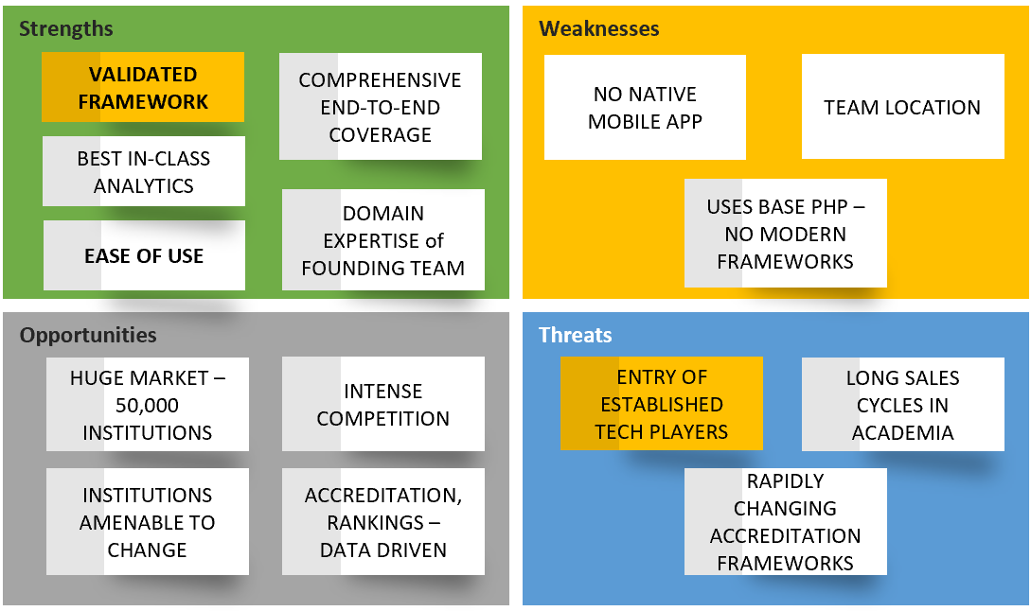

not applicaible
A Federated Learning Model

Slide 7
Strategy Diamond-PI 360
Where will we be active?
How will we get there?
Personal Networks, Direct Sales, Ed-Tech Forums, Institutional Networks, Pan-India and SAARC, Middle-East, SE Asia.
Reference Customers, Dedicated Sales and Customer Engagement Teams, Best in-class Service, Value-Added Services, Mentoring
Arenas
Vehicles
Economic Logic
Staging
Differentiators
What’s the sequence of moves?
How will we win?
10 pilot and reference customers, Propagation through institutional clusters such as IUCEE, ICT Academy, Marketing Campaign by F&S, Sales and Dev Teams near market.
Product Differentiation, Quality and Speed of Innovation, Simplicity and Ease-of-Use, Value-Added Third-Party Service Integration, Deep Institutional Engagement, Strategic Partnerships
How will returns be obtained?
Command premium for unique features, value proposition, quality of service. Obtain premium in overseas markets. Revenue sharing with third-party service providers.

Slide 8
Market Analysis
Total Available Market
50K Institutions
Total Serviceable Market
10K Institutions
Serviceable Obtainable Market
2.5K Institutions
15% of Colleges (6000) and 75% of Universities are NAAC/NBA Accredited
600 New Universities and 10k Higher Education Institutions expected in next 5-7 Years
AICTE has made NBA Mandatory for 60% of the departments
We aim to capture 25% of the TSM market in the next 10 years – 2500 to 3000 institutions/colleges

Slide 9
Feature Comparison Matrix --------------- IP-InPods CC – Creatrix Campus EP – E-Pathshaala
Features | PI-360 | IP | CC | EP
NAAC Framework | End to End | Partial | Partial | Partial
NBA Framework | End to End | NA | Partial | Partial
Performance Benchmarking and Dashboards | Yes | NA | NA | NA
Research Dashboard-Google Scholar Integration | Yes | NA | NA | NA
AI and RPA Based Features | Yes | NA | NA | NA
360 Degree Feedback Module | Yes | Partial | Partial | Partial
Alumni Dashboard- LinkedIn Integration | Yes | NA | NA | NA
Automated Faculty Appraisals | Yes | NA | NA | NA
Automated Resume Generator | Yes | NA | NA | NA
Gamification/Automated Guidance and Counselling | Yes | NA | NA | NA
Custom Reports | Yes | NA | NA | NA

Slide 10
Go to Market Plan
Acquire 10 strategic pilot customers and make them reference customers
Focused Marketing Team covering South India to begin with
Leverage EdTech forums, specialized forums like IUCEE, ICT Academy
Create dialogue around institutional transformation and aggressively position PI-360 as a key component for transformation through marquee events.

Slide 11

Potential Customers
Individual Colleges
Universities (private)
State Technical Universities ( can adopt overarching quality benchmarking framework for affiliated colleges) – VTU, GTU, PTU, UPTU etc.
State Universities – for managing affiliated colleges.

Slide 12
PI-360 – Current Deployments / prototypes
Model Institute of Engineering & Technology, Jammu – 1500 users
Model Institute of Education & Research, Jammu – 500 users
TERNA Engineering College, Mumbai – 2500 users (revenue – 5.75 Lakhs per annum)

Slide 13
Financial Projections
500 quality-conscious institutions with avg. 2000 students + faculty (user accounts) in time span of 5-7years
Conservative estimates @ 30 Rs./user/month will yield revenues of 3.6 Cr (Year 1), 9 Cr (Year 2), 18 Cr (Year 3), 28.8 Cr (Year 4) and 36 Cr (Year 5)
Once customer data is locked-in, drop out rates are expected to be low.
Customizations, feature enhancements shall be chargeable as extra
Perpetual Revenue Model with increase every 2 years, introduction of premium features to enhance revenue realization

Slide 14
Allied Business Opportunities
Third-party accreditation (envisaged in New Education Policy)
Consulting – SOUL (Strategy, Operations, Urgency, Leadership) Model
Automated Rankings and Ratings for participating institutions
Student performance management – Electronic Education Records - independent of institutions
Value-added services for students (trainings, coaching/mentoring) on pay-per-use model from within PI-360

Slide 15
PI-360 – Feature Evolution
Integrated Testing for Students – psychometric, competencies, skills – leading to training needs identification, individual development plans and guidance and counseling
Use of AI and predictive analytics – dropouts, faculty fitment, academic outcomes, chatbots
Native Mobile Application
Voice Interface (Alexa)
Social Media Integration
Knowledge Management – Personalized and curated content delivery for students and faculty
APIs for third-party integration and creation of value-added services

Slide 16

THANK YOU

